Slide 1
Linear Regression

Slide 2
Outline
What is Linear Regression?
Modeling Linear Regression
Motivation: Why Linear Regression is important
In Class Projects

Slide 3
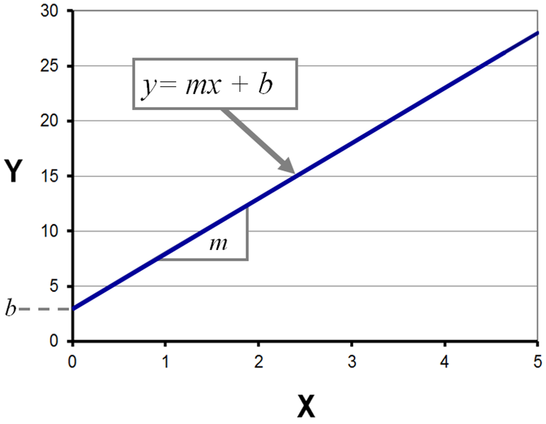
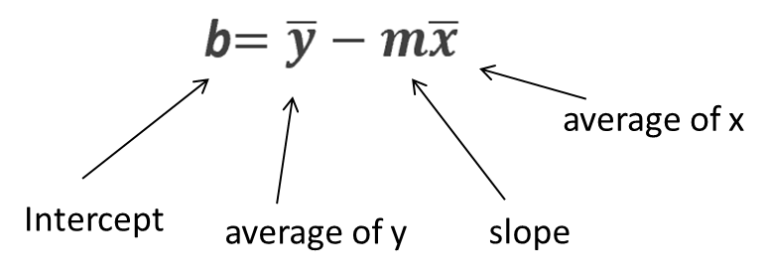
Introduction to Linear Regression
Linear regression is a statistical method used to model the relationship between a dependent variable and one or more independent variables. The simplest form is simple linear regression, where we model the relationship between two variables as a straight line.

Slide 4
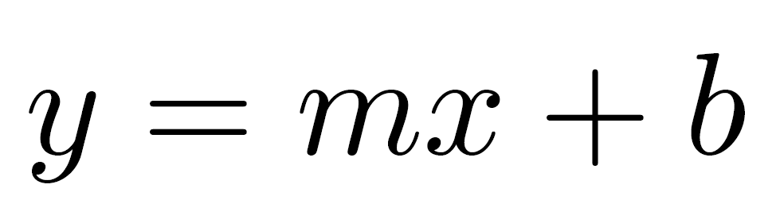
Basics of Linear Regression
In simple linear regression, we have the dependent variable y, and the independent variable x, and we try to fit a line that best describes the data. The equation of this line is:
here m is the slope of the line, and b is the y-intercept. The goal is to find the values of m and b that minimize the difference between the predicted values and the actual values.

Slide 5
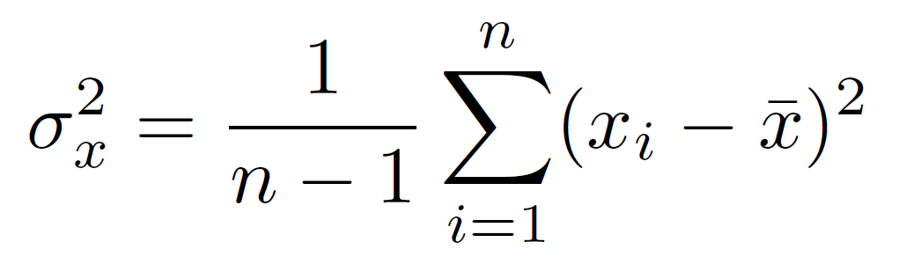
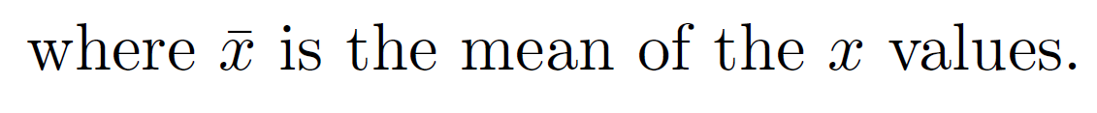
Understanding Variance and Covariance
Variance measures the spread of a set of numbers. If we have a set of numbers x1, x2, . . . , xn, their variance is calculated as:
Variance is like telling us how much the numbers in a group differ from each other. If everyone in a class is about the same age, they don't vary much, so the variance of their age is small. But if some are very old and some are very young, they're all over the place—that's a big variance!

Slide 6
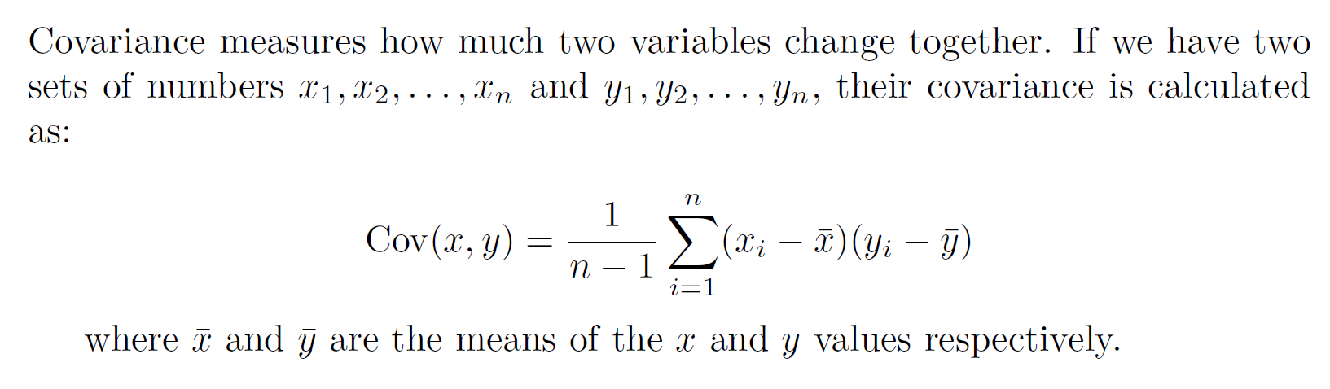
Understanding Variance and Covariance
Covariance is a way to figure out if two things move together. Imagine you and a friend walking together. Every time you take a step forward, your friend does too. If your steps (the distance each of you walks) usually match up, you have a positive covariance with your friend's steps—meaning you're moving in the same direction together. But if when you step forward, your friend steps back, then your steps have a negative covariance, meaning you tend to move in opposite directions. If there's no clear pattern to your steps compared to your friend's, then the covariance is close to zero—meaning there's no particular connection in the way you're moving.

Slide 7
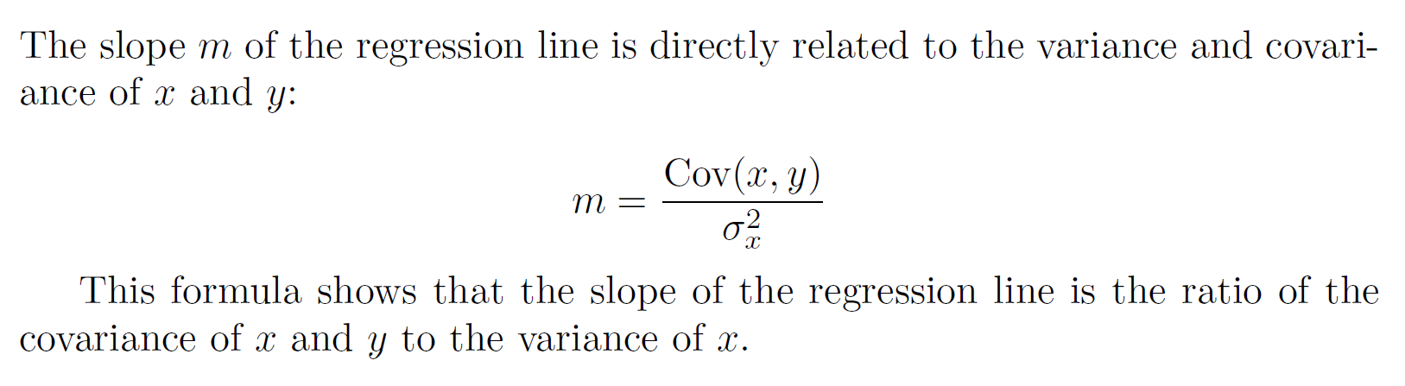
Variance and Covariance in Linear Regression

Slide 8
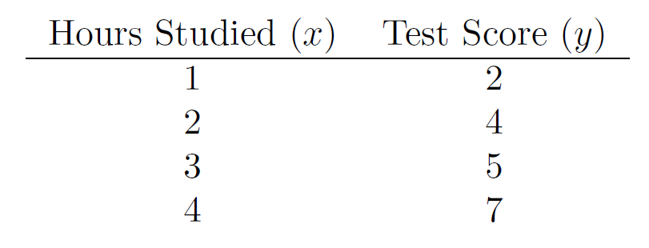
Example Calculation
Let’s consider an example with the following data points to demonstrate how variance and covariance are used to calculate the slope of the regression line.

Slide 9
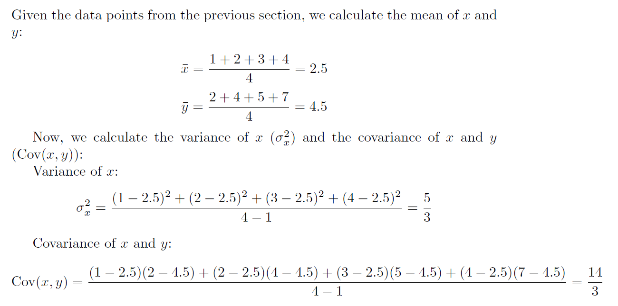
Calculating Variance and Covariance

Slide 10
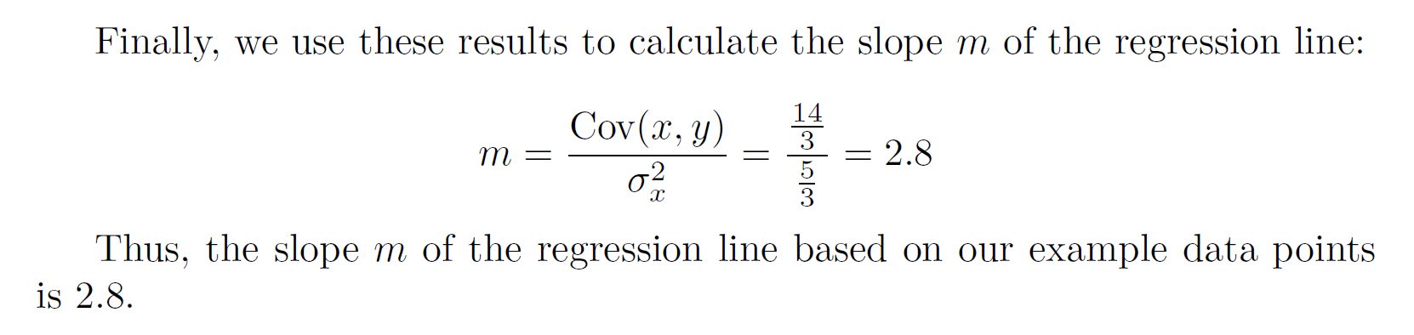
Finding the Slope

Slide 11
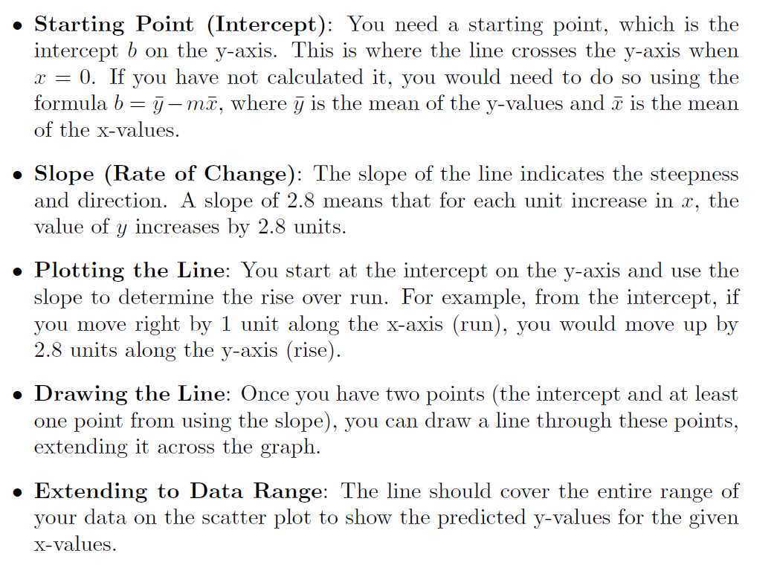
In the context of linear regression, once you have the slope (in this case, 2.8 according to the example), you can plot the regression line with respect to your data points. Here’s how the line is drawn:

Slide 12
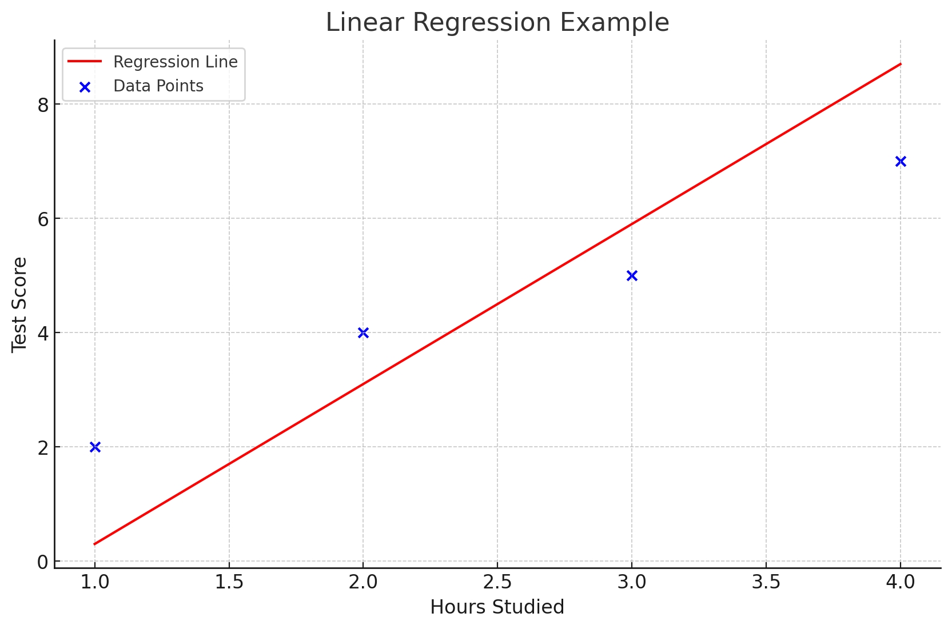
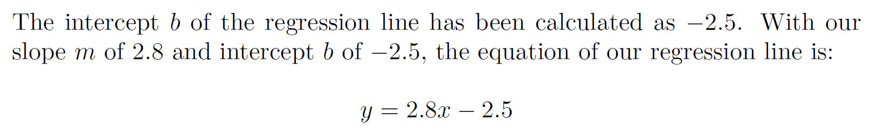
Example plot
In the plot, the blue dots represent the given data points, and the red line is the regression line that has been drawn based on our calculated slope and intercept. This line visually demonstrates how the test score y increases with the number of hours studied x.

Slide 13
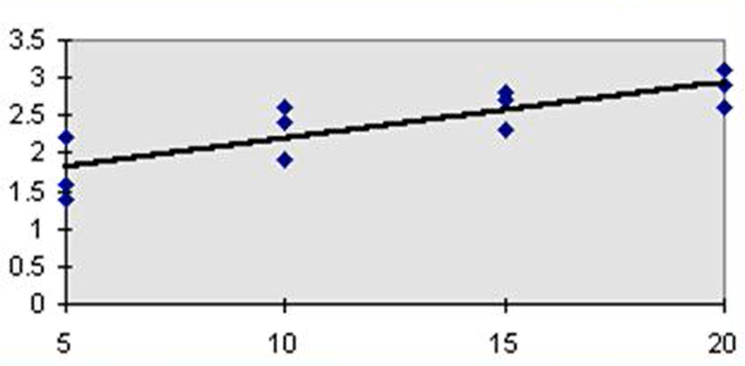
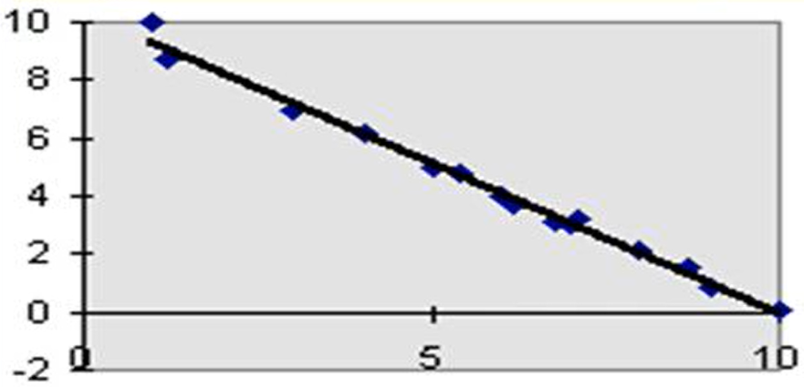
Linear Regression Types
x: input variable
y: output (target)
Positive Linear Relationship
Negative Linear Relationship
y
y
x
x

Slide 14
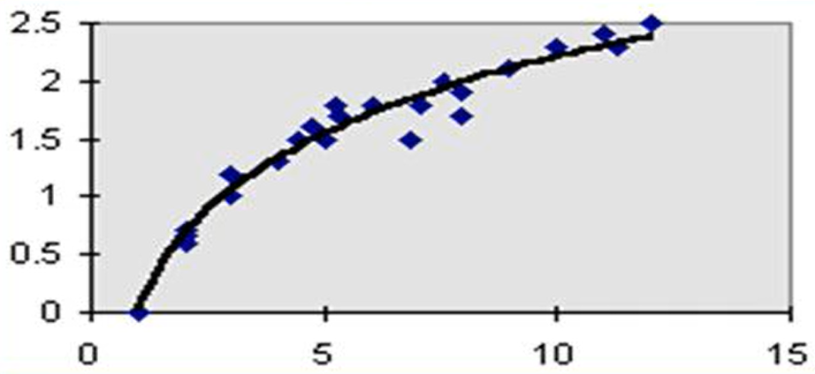
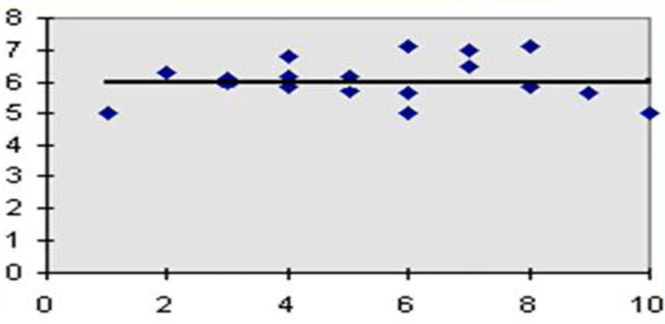
None-Linear Regression Types
x: input variable
y: output (target)
No – Linear Relationship
No - Relationship
y
y
x
x

Slide 15
Motivation: Why Linear Regression is Important?
Linear Regression is used for :
1. Predictive Modeling
Can we predict the score of the students based on hour studies?
2. Forecasting, Time Series Modeling
What is the sales of a product in future months ?
3. Medicine
Does blood pressure affect heart diseases ?

Slide 16
In Class Project 1
Home Prices In Finland
Area (square feet) | Price (Euros)
2600 | 550000
3000 | 565000
3200 | 610000
3600 | 680000
4000 | 725000
Given these home prices,
find out home prices for the following:
3300 square feet
5000 square feet

Slide 17
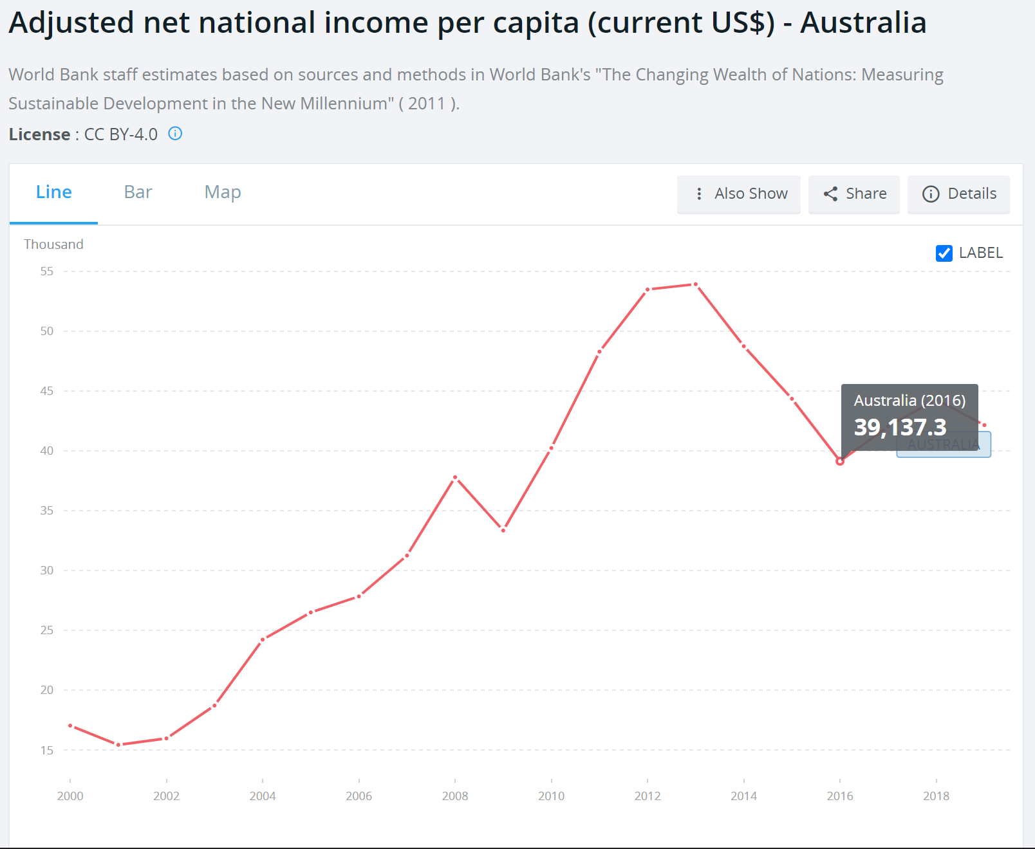
In Class Project 2
Given these income per capita
according to years, find the per capita
income of Australia in years :
2023
2030
https://data.worldbank.org/indicator/NY.ADJ.NNTY.PC.CD?locations=AU

